Slide 1

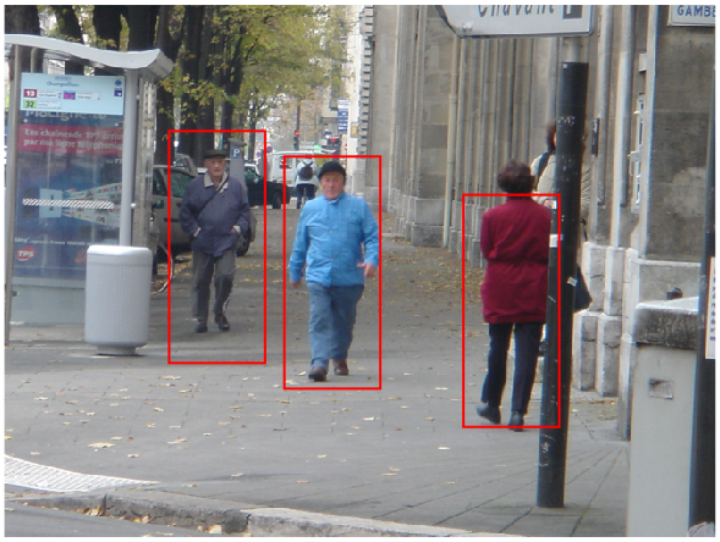
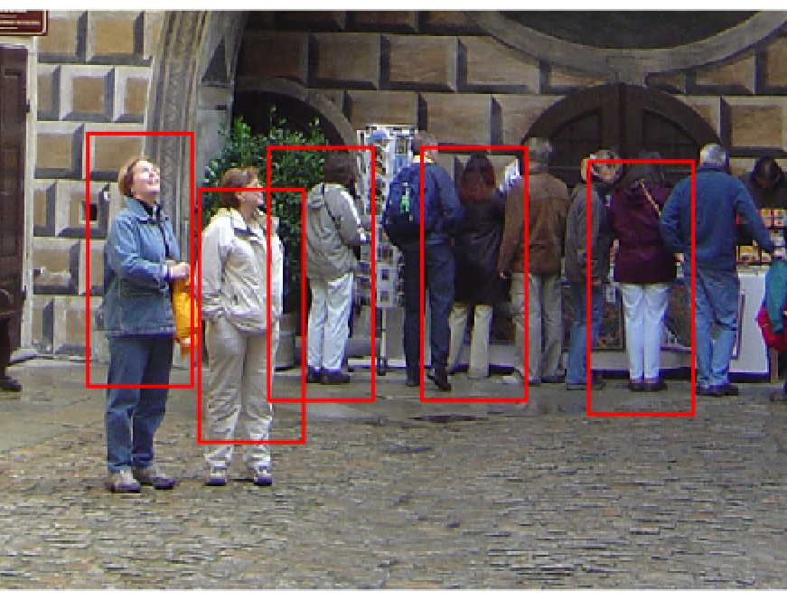
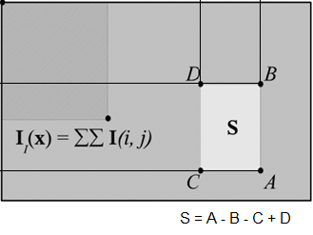
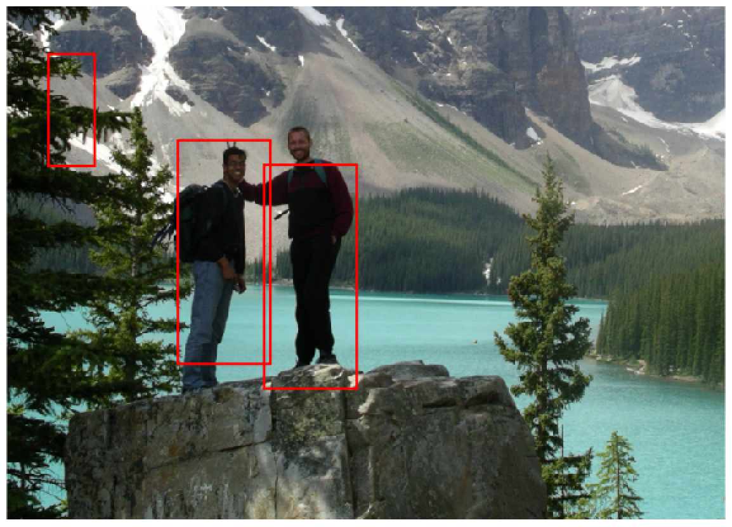
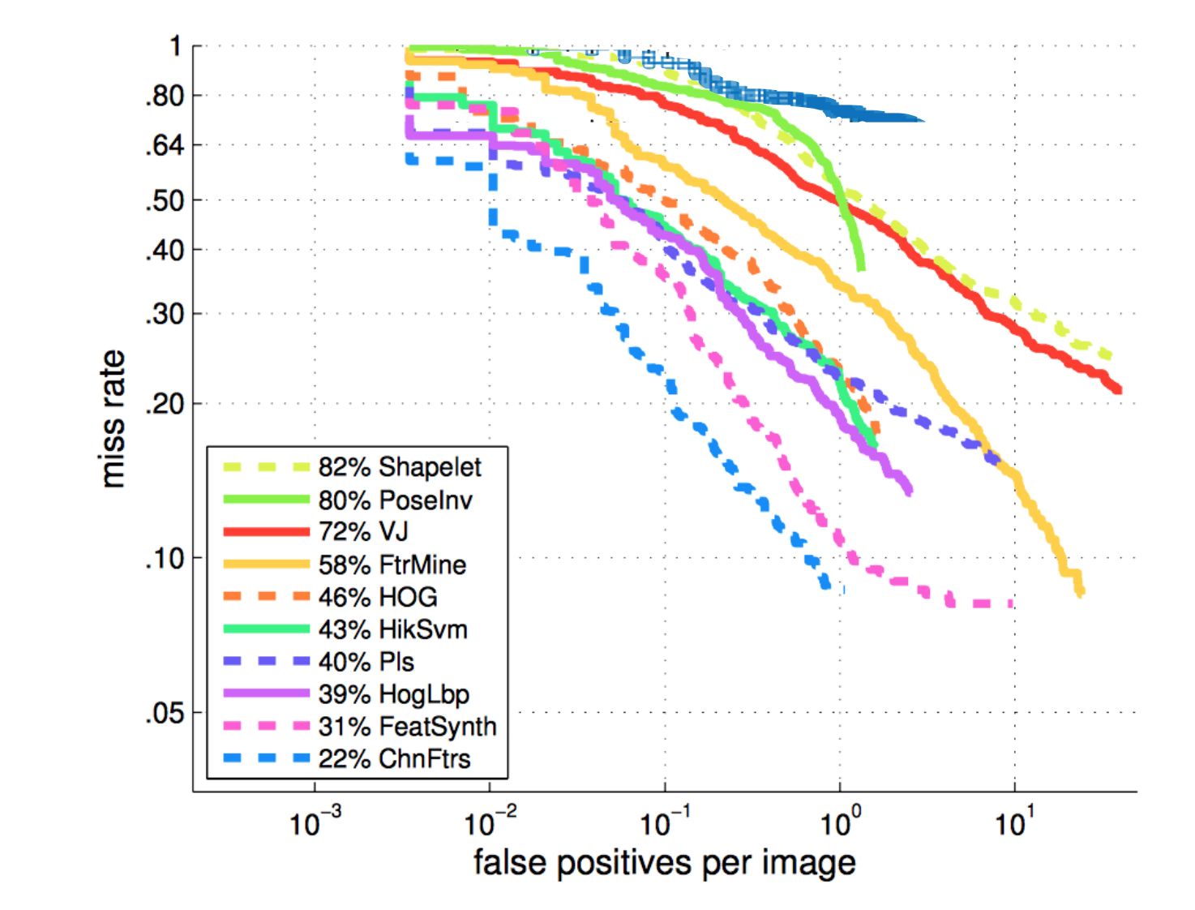
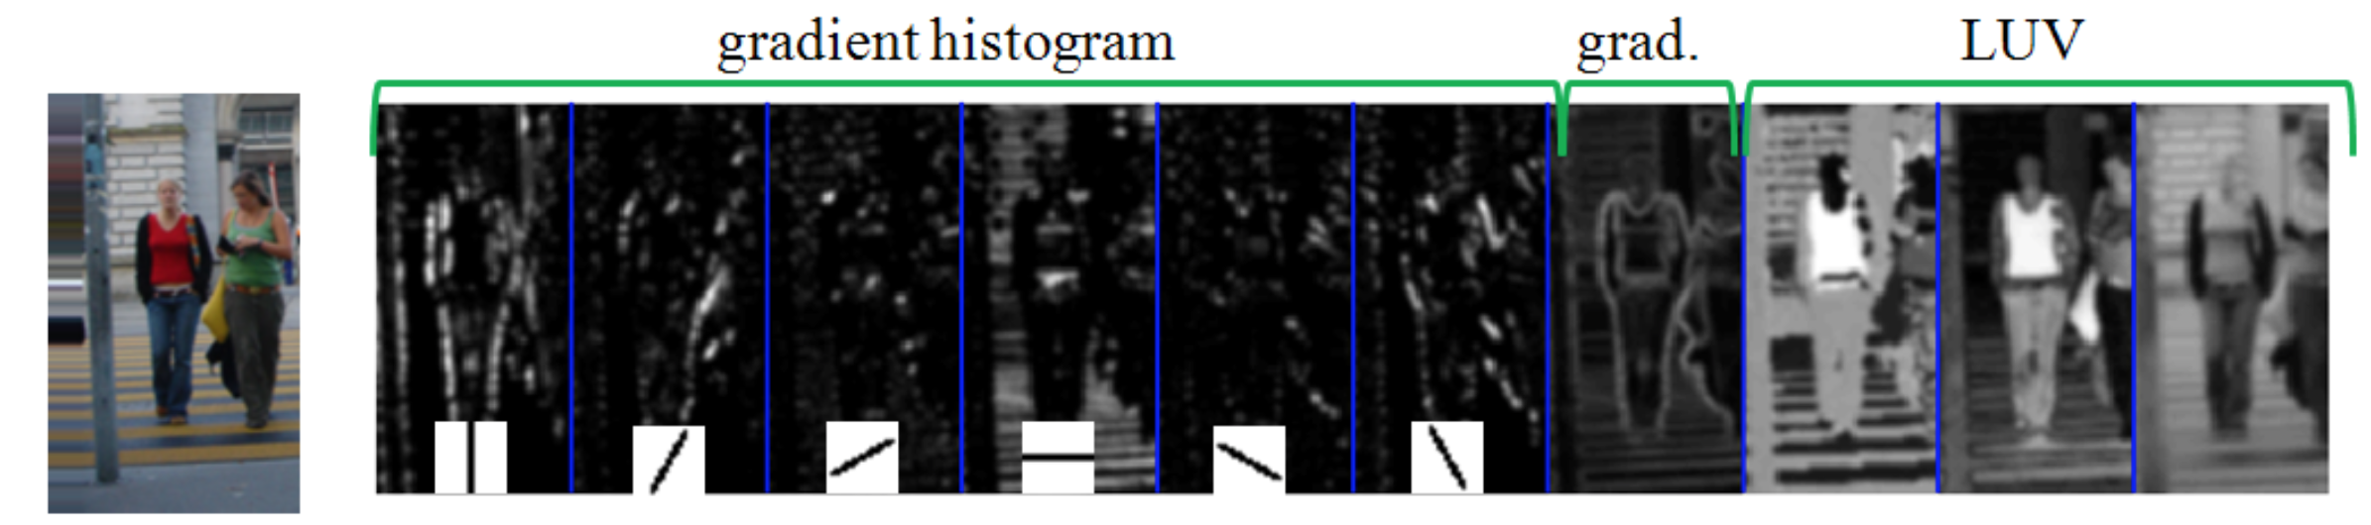

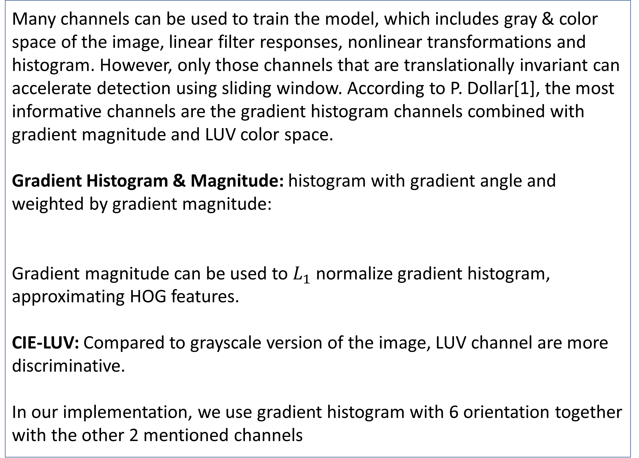
Pedestrian Detection Using Integral Channel Features
Shiyuan Chen (shiyuanc); Taoran Dong (tdong)
Carnegie Mellon University
Abstract
Integral Channels and Features
Pedestrian detection in computer vision has many important applications, such as autonomous vehicles, surveillance and traffic signal control. Over the recent decades, many approaches have been developed to tackle this problem.
In this project, our primary work is to implement a pedestrian detector using the integral channel features approach (known as ChnFtrs detector). Firstly channels are generated by applying various transformations (e.g. Histogram of oriented gradient, color spaces) to the input images. Integral images are computed based on these image channels and features are generated as local sums within random rectangular regions in randomly selected channels. The model is trained using these features via Adaboost algorithm with 3 cascade stages.
The integral image method greatly reduces computation time for both training and testing. Our work shows that even with a very small set of features, this approach can still achieve reasonable detection performance.
First-order Channel Feature: each feature is a sum of the values in a selected rectangular region in a certain channel.
Feature Selection: The position and shape of the rectangular region are both selected randomly over different channel layers. A total of 4000 features are generated to train the detector model.
Advantages: First-order features can be computed extremely fast with 3 floating point operation using pre-computed integral channels[2].
Channel Types
Figure 1. Sample result and evaluation of performance.
Many channels can be used to train the model, which includes gray & color space of the image, linear filter responses, nonlinear transformations and histogram. However, only those channels that are translationally invariant can accelerate detection using sliding window. According to P. Dollar[1], the most informative channels are the gradient histogram channels combined with gradient magnitude and LUV color space.
Gradient Histogram & Magnitude: histogram with gradient angle and weighted by gradient magnitude:
Gradient magnitude can be used to $L_{1}$ normalize gradient histogram, approximating HOG features.
CIE-LUV: Compared to grayscale version of the image, LUV channel are more discriminative.
In our implementation, we use gradient histogram with 6 orientation together with the other 2 mentioned channels
Training & Testing
Results & Conclusions
Dataset: INRIA Person dataset are used, which contains 2416 positive images for training. 7296 negative windows are generated randomly from 912 negative images. The testing dataset contains 228 full images with ground-truth bounding box annotation.
Training method: A cascade pedestrian detector is trained using Adaboost method in which decision stumps are used as the weak classifier . To strike a balance between computation cost and the detection performance, a total of 3 cascade stages with 80, 200 and 500 week classifiers respectively are used.
Testing method: Our model is tested on the full images (avg. 500 x 612) using sliding window method with image pyramids. A total of 3 octaves, 2 levels per octave is used to scale the testing images.
Compared to the original Viola-Jones object classifier, our implementation reduces the training time significantly to 50 minutes and the testing time to average 16s per image for multiscale detection in a 500 x 612 image without parallelization.
However, the performance of our implementation didn’t reach that in the reference paper[1]. There are 3 main reasons:
Number of features. To control the experiment time, we use only 4000 features, while [1] used 30,000 features. According to [1], using a larger number of features will greatly improve the detection rate.
Number of weak classifiers. The most number of weak classifiers in our cascade is only 500 compared to the 2,000 used in [1].
Limited pyramid scales.
The integral channel features method used in our project has following advantages:
can easily integrate different types of channels
has very few parameters
is fast enough with good performance when coupled with cascade classifies.
Table 1. Optimizations
 | Test time per image
No integral channel, no cascade | ~20 min
Integral Channel, no cascade | ~5 min
Integral Channel, 3 cascade stages | ~16 s
Figure 1. Example image and computed channels.
References
Dollár, Piotr, et al. "Integral Channel Features." BMVC. Vol. 2. No. 3. 2009.
Viola, Paul, and Michael Jones. "Robust real-time object detection."International Journal of Computer Vision 4 (2001): 51-52.
Dollár, Piotr, et al. "Pedestrian detection: An evaluation of the state of the art." Pattern Analysis and Machine Intelligence, IEEE Transactions on 34.4 (2012): 743-761.

